Slide 1
How to minimise the ecological impact of a development?

Slide 2
How to minimize the ecological impact of a development?
Once biodiversity value and significance of the habitats and species occurring within the site and the immediate vicinity are evaluated, an assessment of the effects/impacts of the project on these features needs to be made.
Identify measures to avoid, mitigate and/or compensate against effects/impacts.
Avoidance seek options that avoid harm to ecological features.
Mitigation negative effects should be avoided or minimized through mitigation measures typically through the design and/or implementation of the project.
Compensation where there is significant residual negative ecological effects despite mitigation, these should be offset by appropriate compensatory measures.
Enhancements seek to provide net benefits for biodiversity over and above those required for avoidance, mitigation and compensation.
Opportunities for potential enhancements that will result in net gain should be considered.
Effects/impacts need to be considered for: demolition, construction and operational phases.

Slide 3
Avoidance
Calcareous grassland, hedgerows, TPO trees, woodland edge and boundary with adjacent wildlife site
Pre- development
Revise proposals to:
Retain largest areas of calcareous grassland.
Retain areas that support notable orchid populations.
Retain hedgerows and trees with TPO’s.
Demolition & Construction Phases
Protect habitat areas with fencing/screening, ensuring an adequate buffer zone against disturbances.
Operational Phase
Agree a 10+ year management strategy for the site e.g., with local wildlife groups with costs contributed by developer.

Slide 4
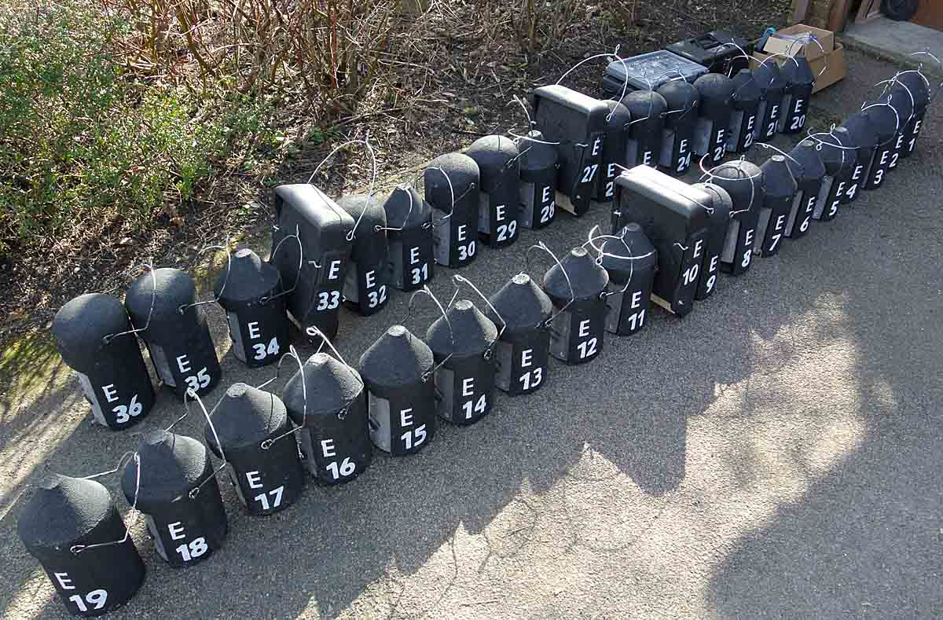
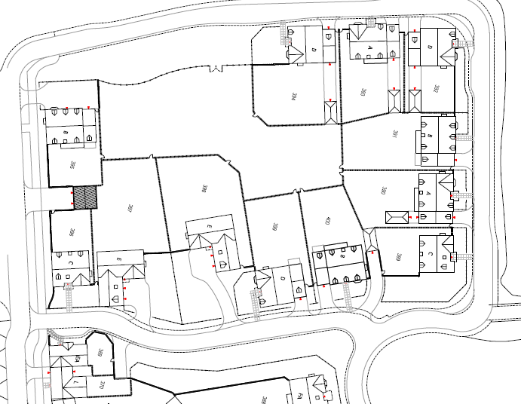
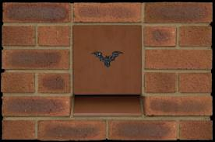
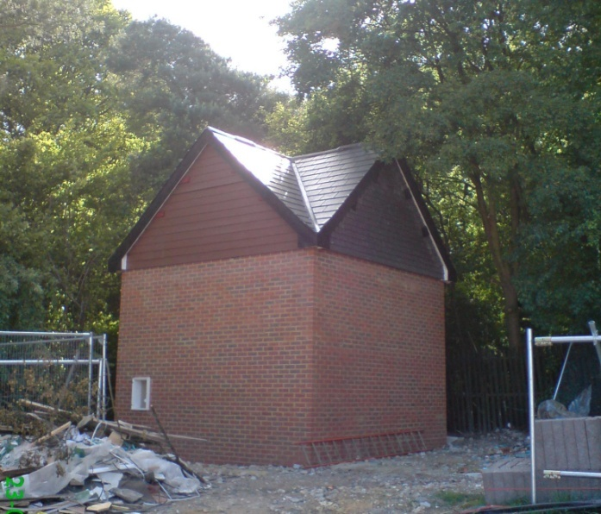
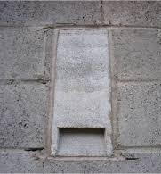
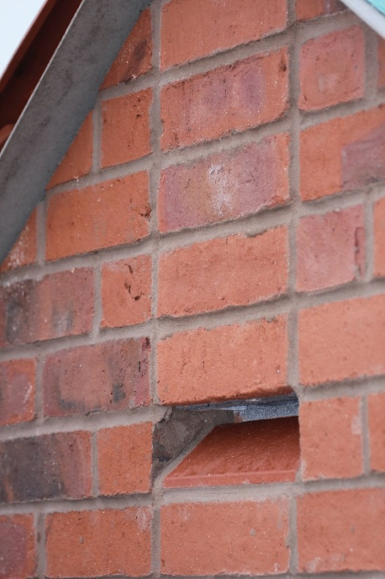
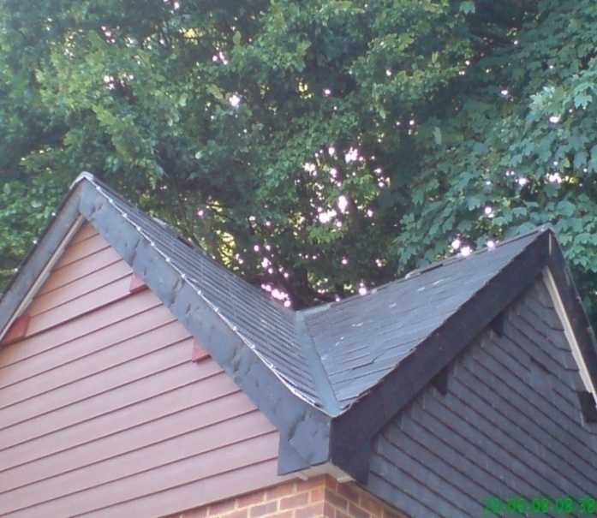
Mitigation – bats and breeding birds
To be agreed under licence by Natural England
Pre- and post- development
Provide alternative roost/nest.
Incorporate replacement roost/ nest sites within new buildings.

Slide 5
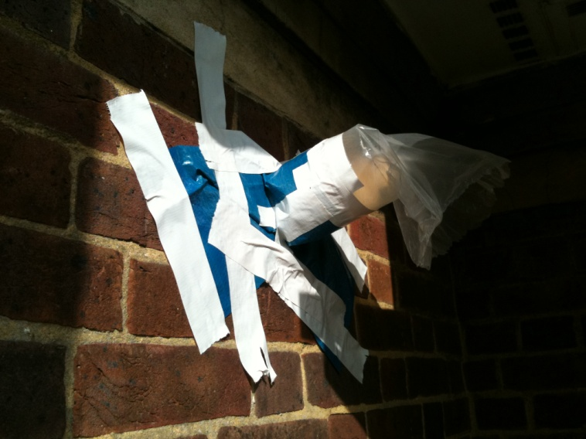
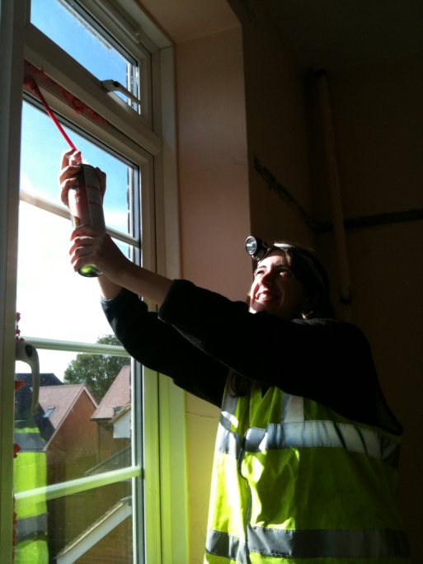
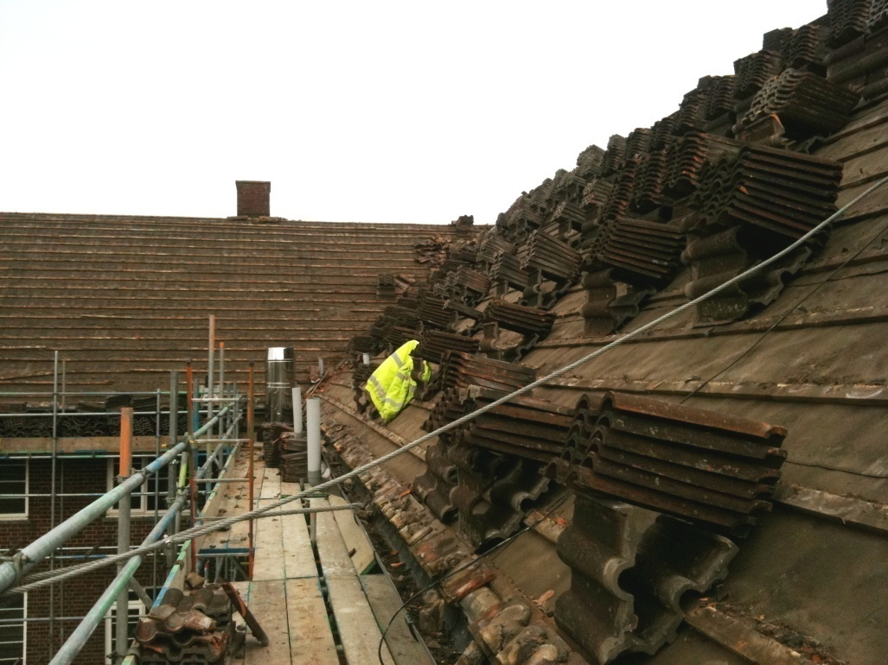
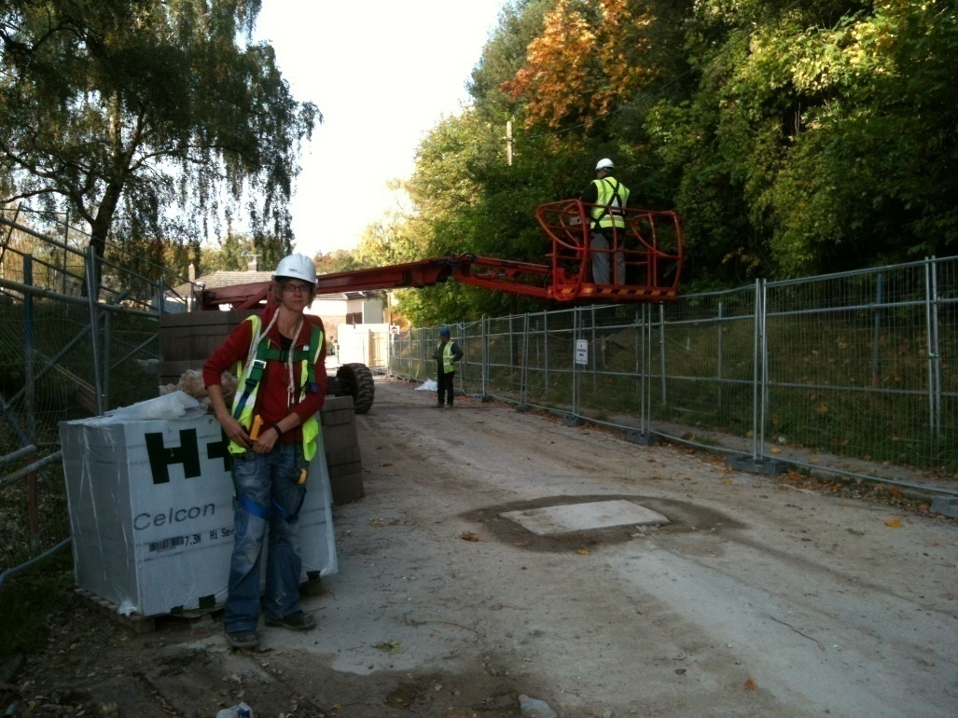
Mitigation – bats and breeding birds
Pre-development
Program works to occur outside of sensitive breeding/ hibernation periods.
Exclude bats/nesting birds prior to works.
Demolition
Soft strip demolition of buildings under a watching brief.
Construction
Replacement roosts within new buildings.
Operational
Post-development monitoring.
Sensitive lighting scheme.

Slide 6
Mitigation and compensation – GCN & reptiles
GCN – under licence from Natural England
In this example, no ponds occur within 500m of the site therefore incidence of encountering GCN is low-negligible. The process of mitigation is similar to that taken for reptiles. Refer to: GCN mitigation guidelines.
Pre-demolition
animals to be moved off site to avoid harm during demolition/construction phases.
Identify a suitable translocation site and undertake appropriate habitat enhancements
Install ‘reptile’ fencing
Monitor populations with felts/tins and relocate animals to translocation site.
Gradually reduce the height and extent of vegetation and capture and relocate animals
Demolition Phase
No demolition or ground works to be carried out in sensitive areas until 7 days of no captures.
Watching brief over demolition works (destructive searches).
Fencing to be retained until completion of the project.

Slide 7
Mitigation – dormouse and hedgehog
Dormouse – to be agreed under licence from Natural England
In this example, on-site habitat is of low suitability compared to adjacent woodland
Avoidance
Avoidance measures will minimise impacts to dormouse and hedgehog.
Pre-demolition
Surveys for hedgehog following installation of reptile exclusion fencing to ensure none are present.
Vegetation clearance will reduce suitability of the habitat.
Demolition Phase
Destructive searches for hedgehogs and their nest sites.
Construction
Provide permeable fencing between gardens.
Compensation/enhancement
New planting to provide nesting and foraging habitat.
Provision of nest boxes/ hibernacula.

Slide 8
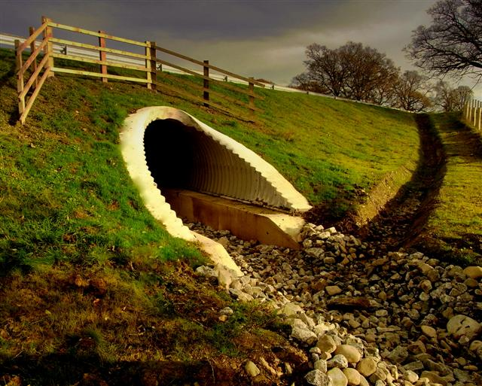
Mitigation - badgers
Pre-development
Exclusion of badger sett under licence from DEFRA.
Alternative (compensatory) sett provided.
Creation of underpasses where passage would otherwise be impeded or associated with high risk.
Badger fencing installed to exclude animals from works area.
Demolition and construction
Machinery and excavation works made safe to avoid adverse impacts.
Compensation
New planting to compensate for loss of feeding areas and to avoid territorial disputes/ competition for resources with neighbouring clans.

Slide 9
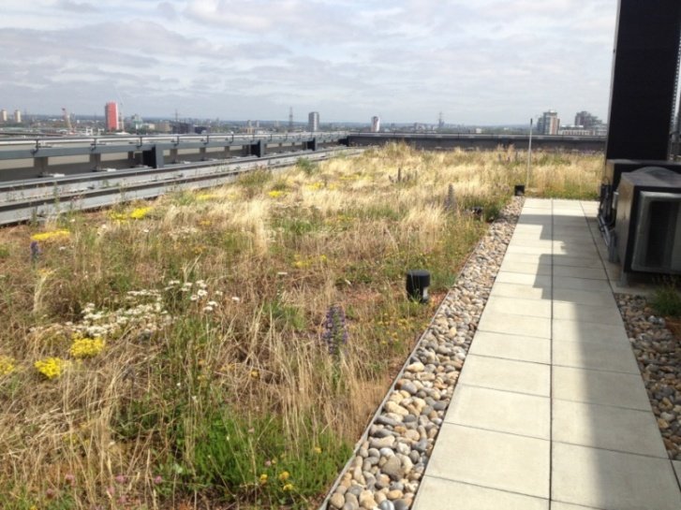
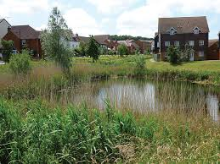
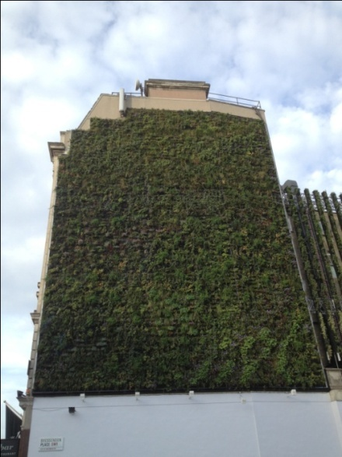
Enhancements
Green infrastructure
Sustainable development proposals
Green roofs
Living walls
SUDS
Sensitive lighting schemes
Habitat improvements such as infill planting of existing hedgerows
Creation of refugia – log piles using logs and brash from vegetation clearance works
Contribution of funds for the long-term management of habitats

Slide 10


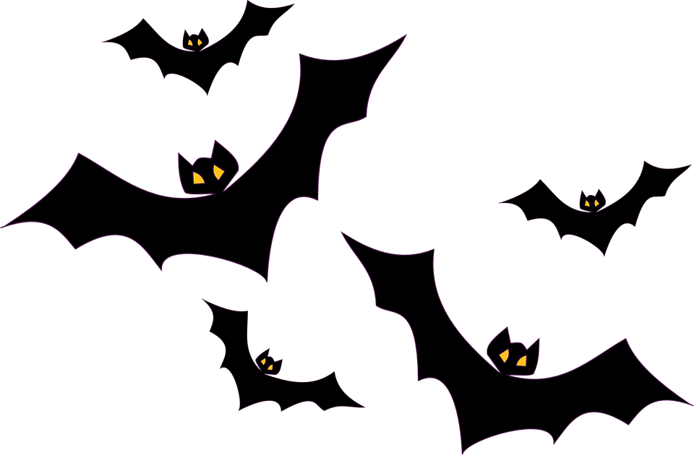
Activity: Mitigation Strategies for Bat Conservation
Hypothetical development of old barn into new housing estate, with street lighting.
Bats roosting in barn roof and commuting to river to forage.
What mitigation strategies would be most effective for ensuring bat conservation?
Notes:
https://www.conservationevidence.com/data/index

Slide 11
Your task
Develop an evidence-based management plan for reducing the impact of a proposed barn conversion on roosting bats.
Look at the building plan and consider alternative avoidance/mitigation/enhancement options.
Use the Conservation Evidence website to identify the effectiveness of different approaches for bat conservation.
Evaluate the evidence and create your final recommendations.

Slide 12
Conservation Evidence
https://www.conservationevidence.com/

